Slide 1
Python Environment
Module B.1

Slide 2
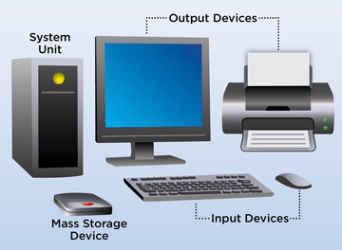
What Is A Computer Program?
A Computer Program controls the hardware of a computer system.
It makes decisions about how Input Devices affect Output Devices
How typing is displayed
What happens when you click a mouse button
Changing the program changes the function of the computer hardware
Word vs. Powerpoint
Word vs. Photoshop
Word vs. Computer Games

Slide 3
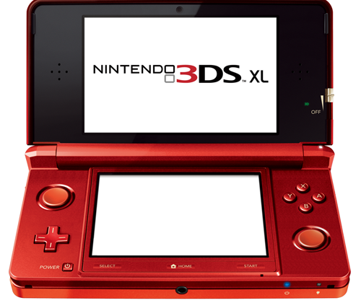
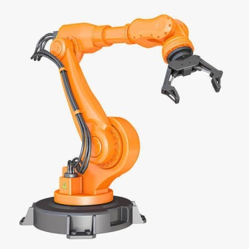
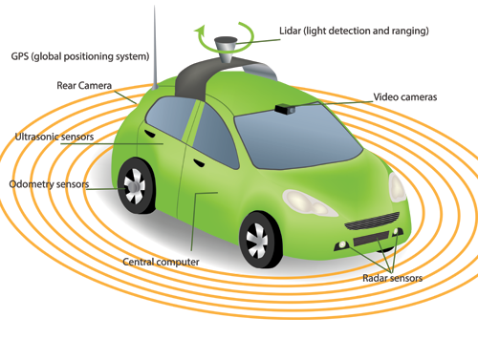
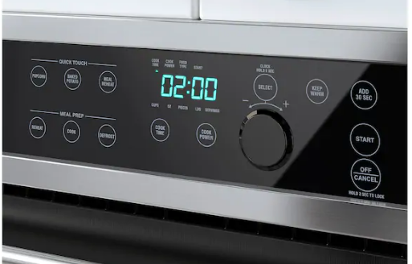
What Is A Computer Program?
Computer Programs control more than just traditional computer systems.
Game systems are dedicated computer systems
Game Pad is just another input device
TV is just another output device
Embedded computers and programs are everywhere
Industrial Robots
Cars (not just self driving)
Kitchen Appliances
internet / Social Media Bots

Slide 4
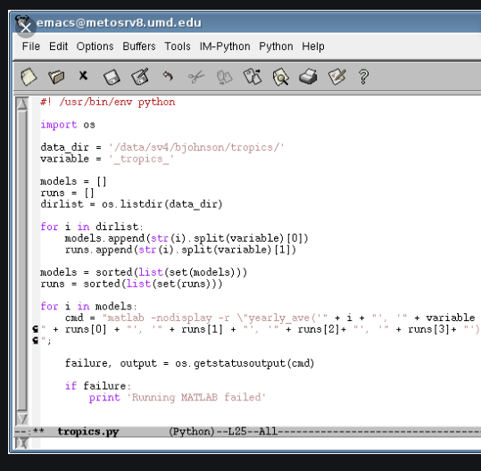
What Is A Computer Program?
Computer Programs are also known as Computer Software
Software uses Logic which is Flexible and easily changed
Hardware uses physical devices which are hard to change
Computer Programs are written in Plane Text
Computer programs are created using a keyboard and editor
Computer programs are stored in a file which may be loaded and executed by a computer
Computer programs can be written in many
different Computer Languages
Each line of a Computer Program is a simple logical statement or command
A complex command may be composed of a dozen logical program statements
A complete computer program may be composed of thousands of lines of computer code.

Slide 5

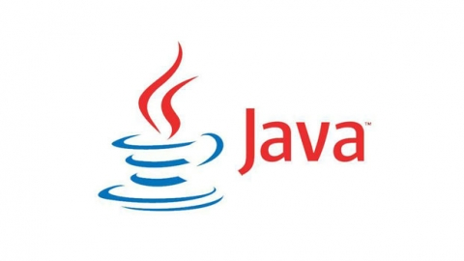

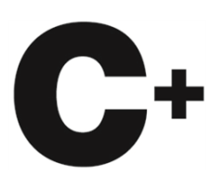
Why The Python Language?
Many computer languages are used for different applications and each have their own strengths and weaknesses
C / C+ for Engineering
Java for Web Application Development
COBOL / SQL for Business
Python is an important computer language
Is a "professional" language with a large user base
Is good for prototyping small programs
It is a good beginner language
It is the language of choice for 1st year university courses
Note: Programming concepts are the same in all languages; Once you learn how to program you can use any language.

Slide 6
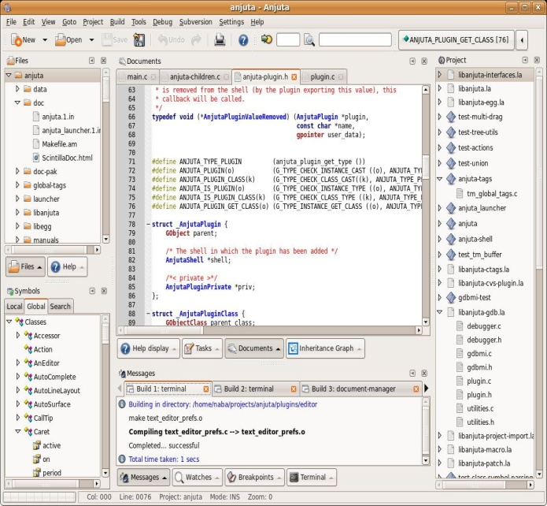
What Is a Development Environment?
Programs may be written using just about any text editor
However they lack supports to make programming easier.
An Integrated Development Environment (IDE) provides extra supports and tools designed specifically for creating and maintaining computer programs
Colour coding of keywords
Indentation and completion control
Error Checking
Runtime support and debugging
There are many Development Environments to choose from
How well does it support your chosen language?
Is it web based or a download install?
Other factors…

Slide 7
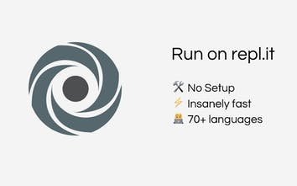

The Repl.it Development Environment
The IDE that we will be using is Repl.it
Goto: www.repl.it
Create your own account
Repel is a web based environment
Accessible at Home / Library
Your programs are stored in the cloud
Repl supports a number of different programming languages
Create a "new repl"
Make sure to choose "Python" (not Python 2.7)
Make Sure version is 3.7.3 (Other versions will not work wit h our sample programs)

Slide 8
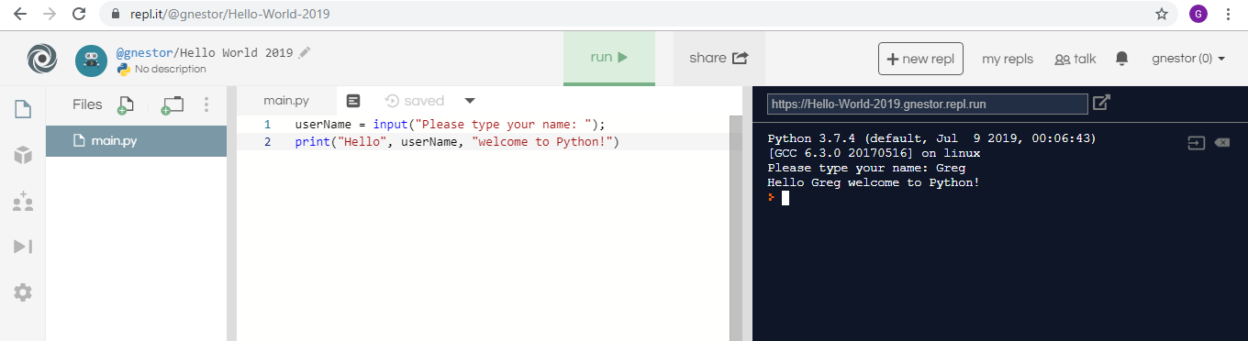
The Repl.it Development Environment
File Chooser
Each Python may have many files (You can add files and folders)
"main.py" is your main program file
Program Editor
Type and edit your program script
Click the "Run > / Stop" button to control your program
Console Input / Output
Displays the output and results of your program
Where you type to answer responses to input prompts from your program
Can also type and run short programs here (like a calculator)

Slide 9
Your Turn
Complete the remaining questions in:
B.1 Student – Python Environment
Upload your answers to your GitHub Repository for credit.

